Slide 1

CCS 2023
赵路路
2024.7.20

Slide 2
Contents
Recall to Payment Channel
Abstract
Introduction
Accio Scheme
Randomizable Signature of Updatable Commitments (RSUC)
Experiments & Conclusion

Slide 3
Contents
Recall to Payment Channel
Abstract
Introduction
Accio Scheme
Randomizable Signature of Updatable Commitments (RSUC)
Experiments & Conclusion

Slide 4
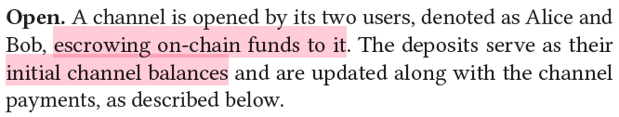
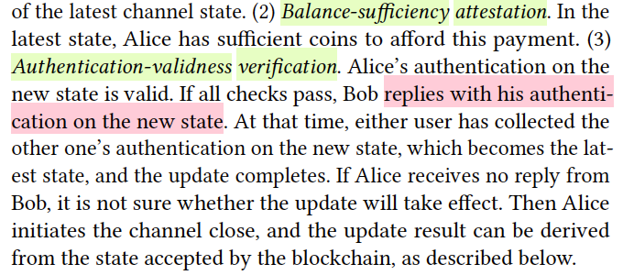
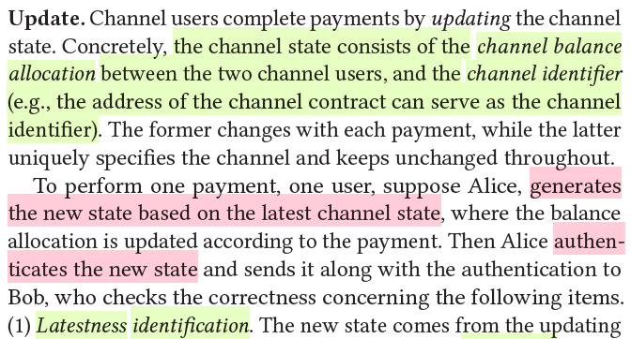
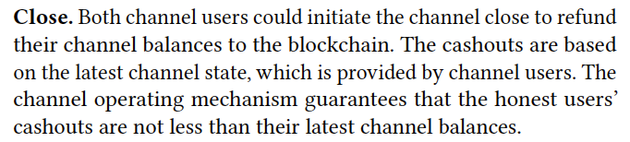
Recall to Payment Channel
Low Scalability: 7 Payments per Second with 1 Hour Confirmation

Slide 5
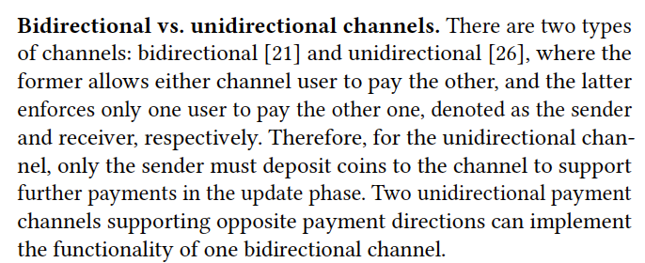
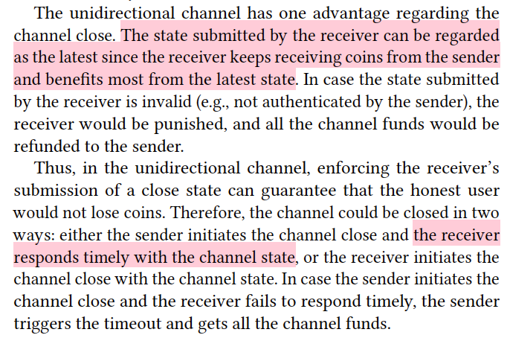
Recall to Payment Channel
Bidirectional vs. Unidirectional

Slide 6
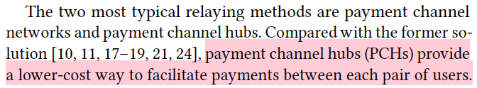
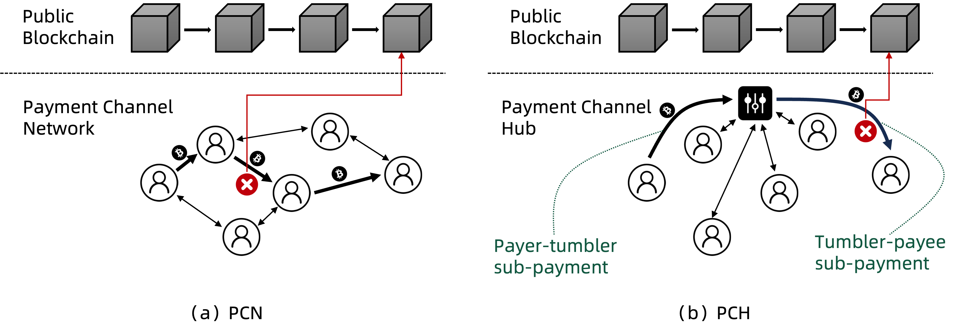
Recall to Payment Channel
Payment Channel Hubs vs. Payment Channel Networks

Slide 7
Contents
Recall to Payment Channel
Abstract
Introduction
Accio Scheme
Randomizable Signature of Updatable Commitments (RSUC)
Experiments & Conclusion

Slide 8
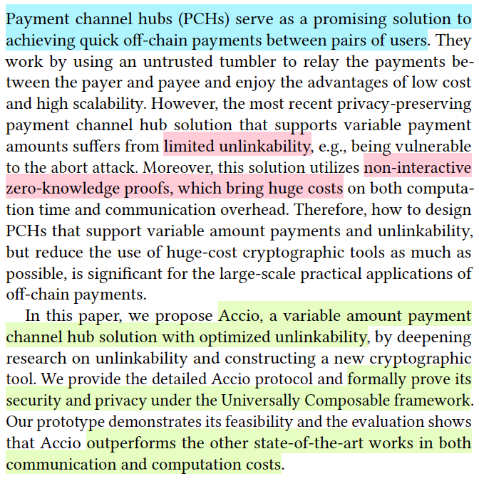
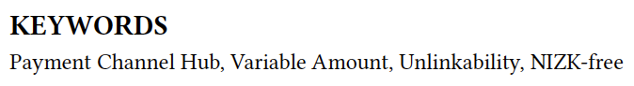
Abstract
Accio: Variable Amount, Optimized-Unlinkability, NIZK-Free PCH

Slide 9
Contents
Recall to Payment Channel
Abstract
Introduction
Accio Scheme
Randomizable Signature of Updatable Commitments (RSUC)
Experiments & Conclusion

Slide 10
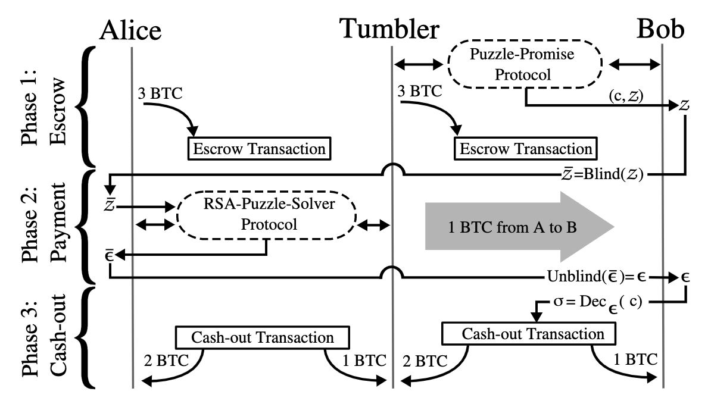
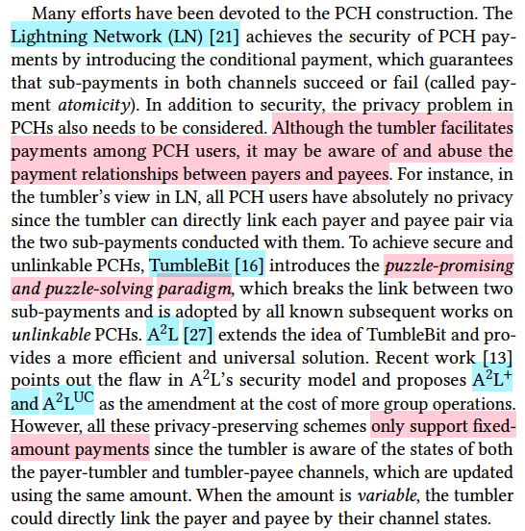
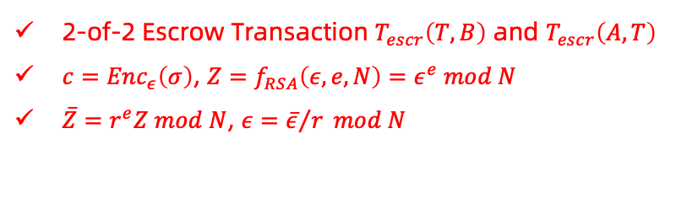
Introduction
2-of-2 Escrow Transaction $T_{escr}\left(T,B\right)$ and $T_{escr}\left(A,T\right)$
$c={Enc}_{ε}\left(σ\right)$, $Z=f_{RSA}\left(ε,e,N\right)=ε^{e} mod N$
$\overline{Z}=r^{e}Z mod N$, $ε={\overline{ε}}/r mod N$
Technological Route (Fixed)

Slide 11
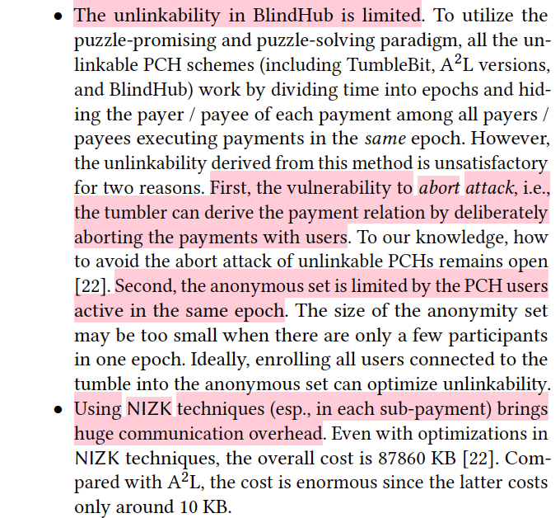
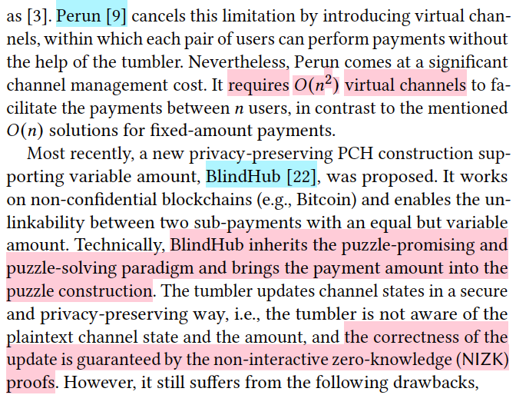
Introduction
Technological Route (Variable)

Slide 12
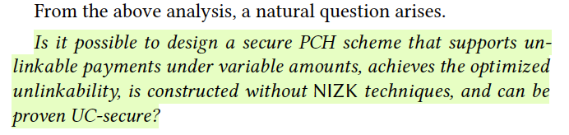
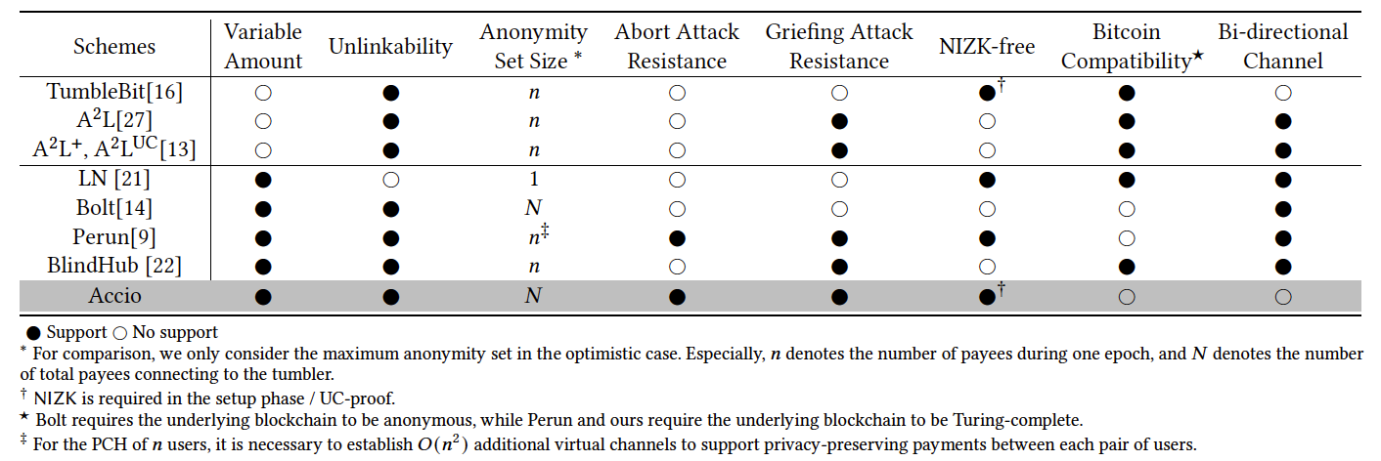
Introduction
Motivations

Slide 13
Contents
Recall to Payment Channel
Abstract
Introduction
Accio Scheme
Randomizable Signature of Updatable Commitments (RSUC)
Experiments & Conclusion

Slide 14
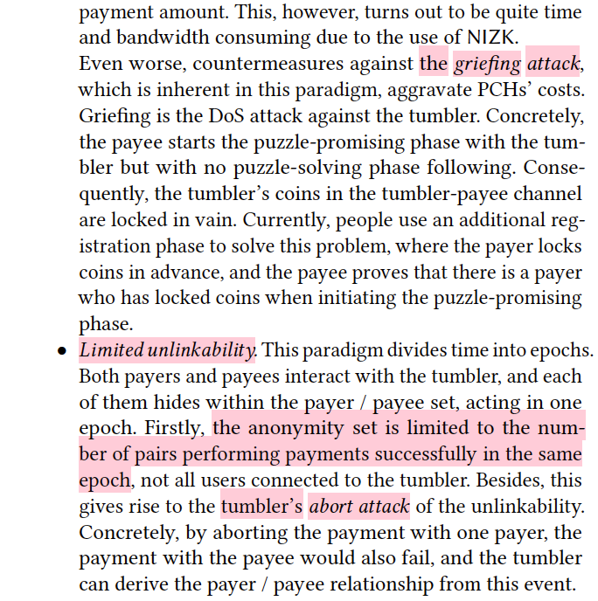
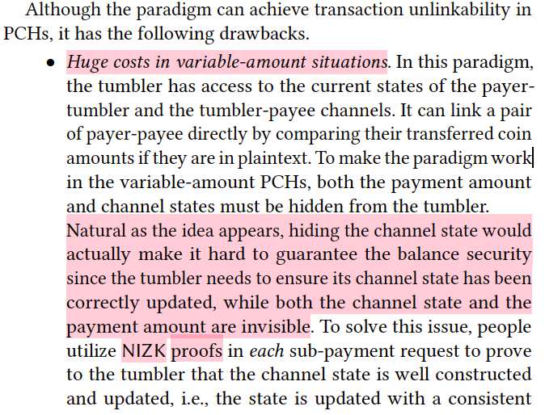
Accio Scheme
Necessity in Replacing the Paradigm

Slide 15
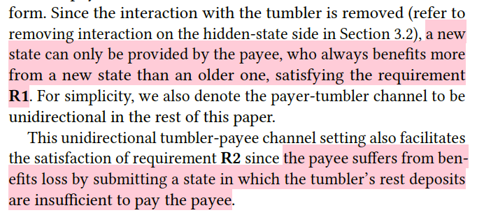
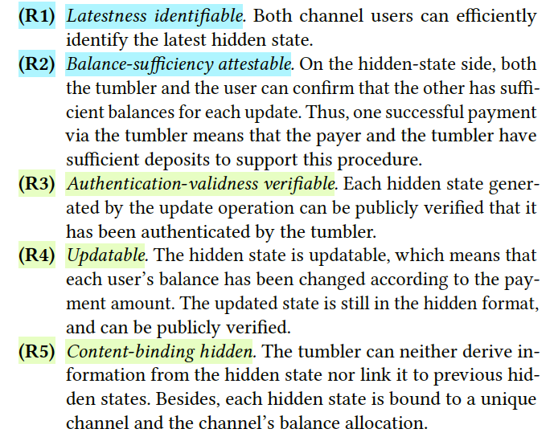
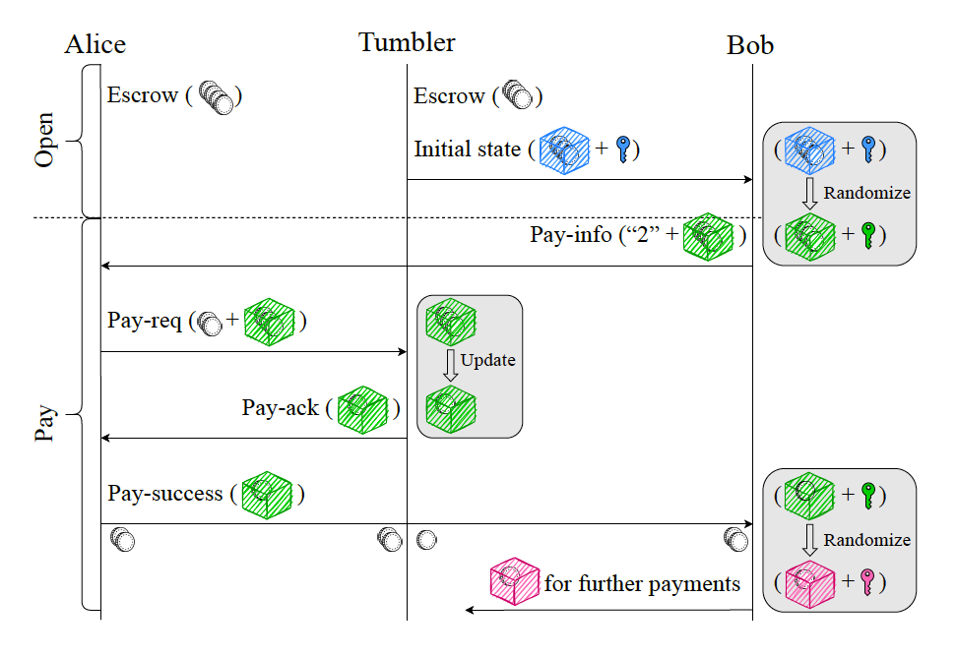
Accio Scheme
Requirements
Notes:
tumbler分布式
reusable一对多 多对一 多对多的交易
支付通道攻击方案CCS21左右 多跳恢复

Slide 16
Contents
Recall to Payment Channel
Abstract
Introduction
Accio Scheme
Randomizable Signature of Updatable Commitments (RSUC)
Experiments & Conclusion

Slide 17
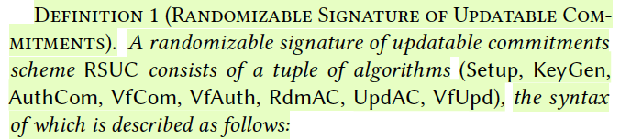
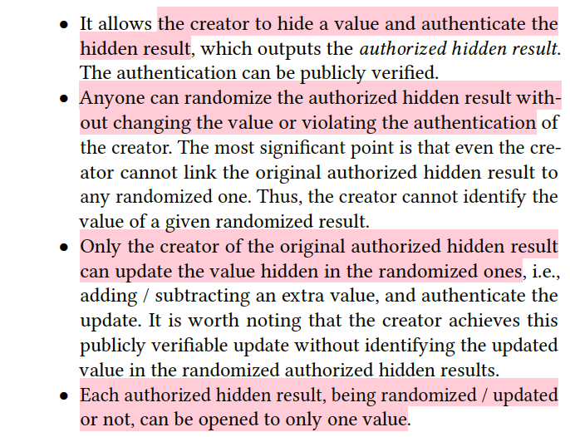
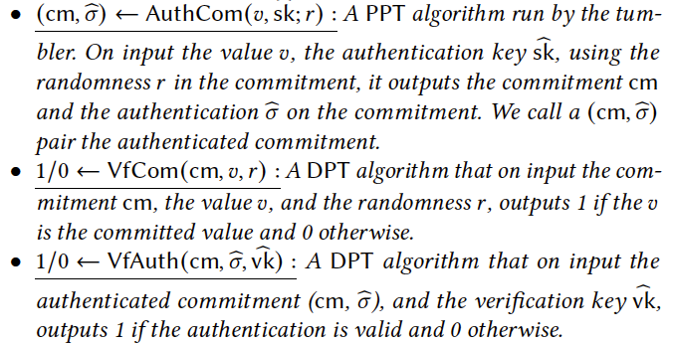
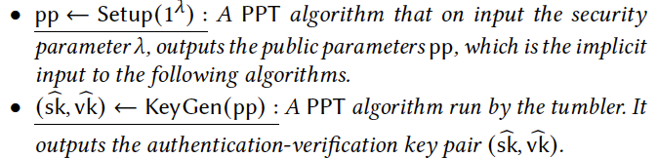
Randomizable Signature of Updatable Commitments (RSUC)
Functionality and Primitives

Slide 18
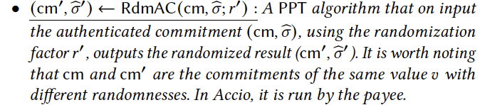
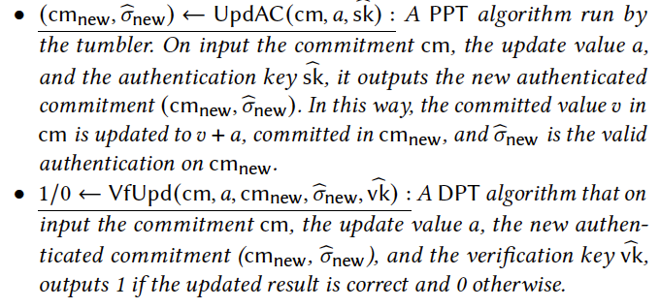
Randomizable Signature of Updatable Commitments (RSUC)
Functionality and Primitives

Slide 19
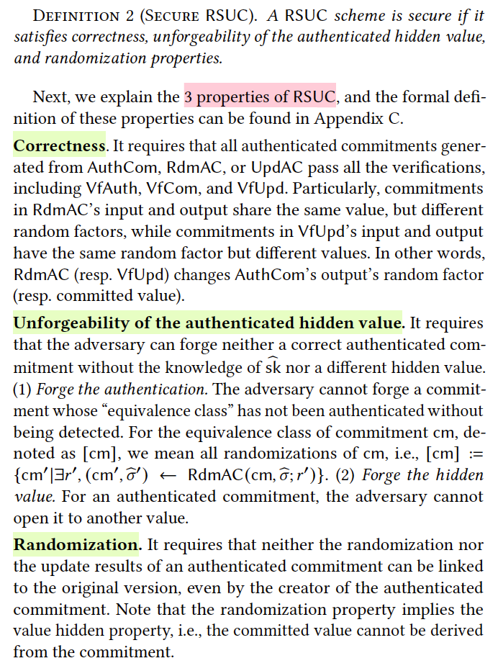
Randomizable Signature of Updatable Commitments (RSUC)
Properties

Slide 20
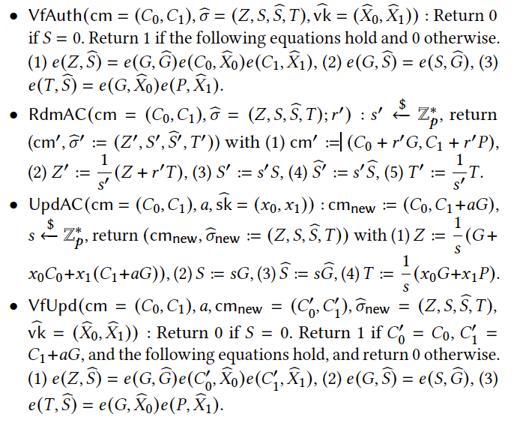
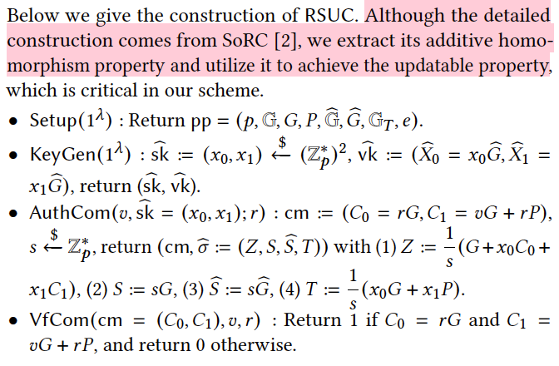
Randomizable Signature of Updatable Commitments (RSUC)
Instance Construction
[2] Balthazar Bauer and Georg Fuchsbauer. 2020. Efficient Signatures on Randomizable Ciphertexts. In Security and Cryptography for Networks, SCN, Vol. 12238. Springer, 359–381.
Notes:
配对 外包计算 预计算一些东西（哪些参数变哪些不变）

Slide 21
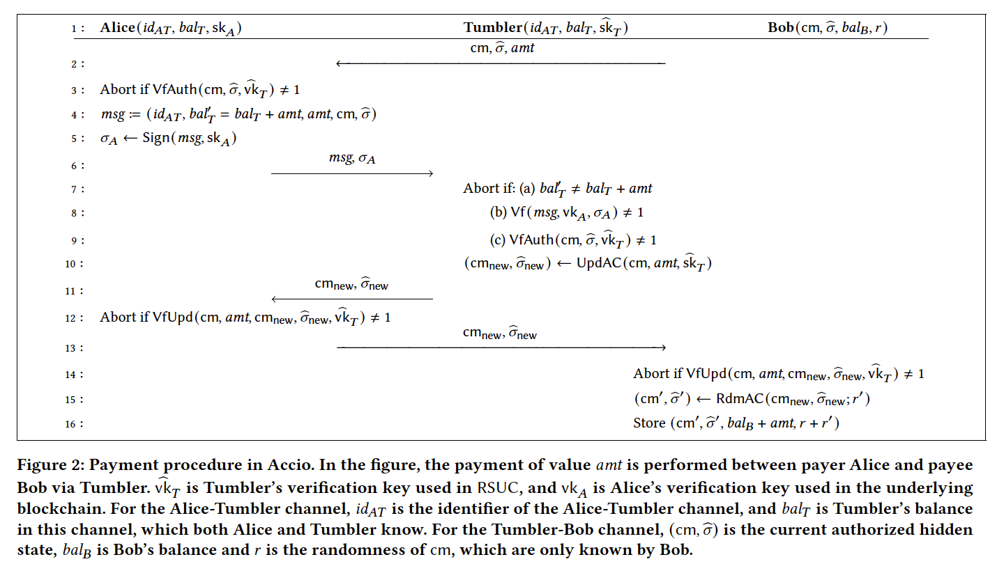
Randomizable Signature of Updatable Commitments (RSUC)

Slide 22
Contents
Recall to Payment Channel
Abstract
Introduction
Accio Scheme
Randomizable Signature of Updatable Commitments (RSUC)
Experiments & Conclusion

Slide 23
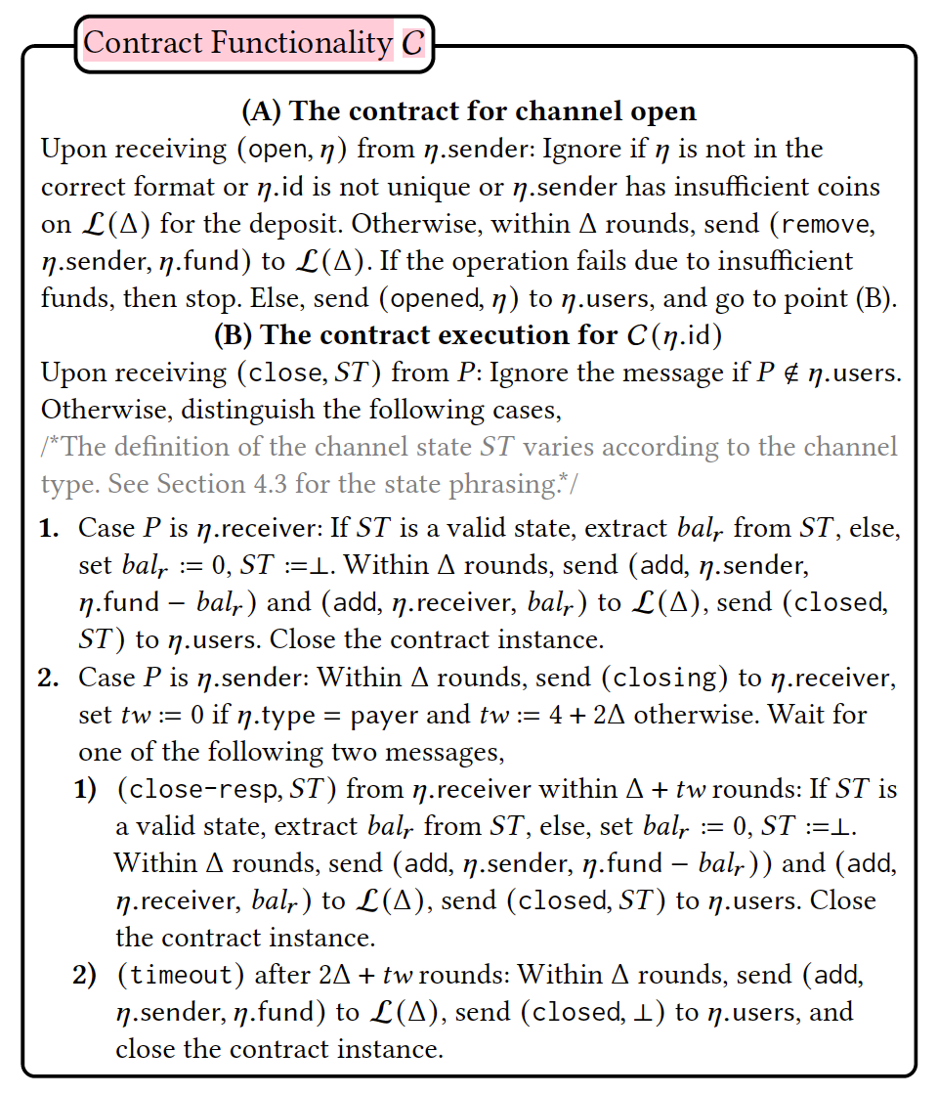
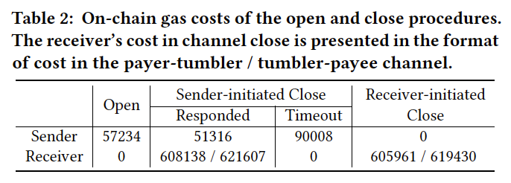
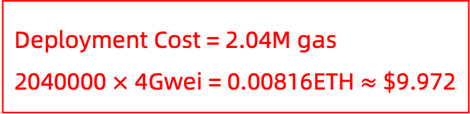
Experiments & Conclusion
Deployment Cost = 2.04M gas
2040000 $×$ 4Gwei = 0.00816ETH $≈$ $9.972
On-Chain Cost
Environment | Value
Blockchain | Ethereum
Language | Solidity
Curve | BN-128

Slide 24
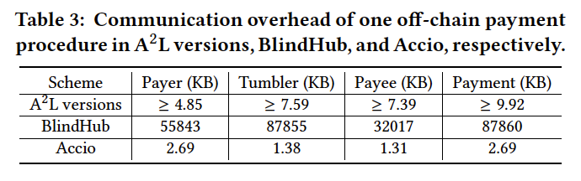
Experiments & Conclusion
linearly/logarithmically
Off-Chain Cost
Environment | Value
Library | MCL
Curve | BN-128
CPU | 8 * 3.20GHz AMD 5800H
Memory | 40GB
OS | Ubuntu 22.0.4.1 LTS
Scheme | Communication Rounds per Transaction / round
A²L versions | 9 = 6 + 3
BlindHub | 9 = 6 + 3
Accio | 4
Scheme | Computational Cost per Transaction / second
A²L versions | 0.223
BlindHub | 9.154
Accio | 0.015

Slide 25
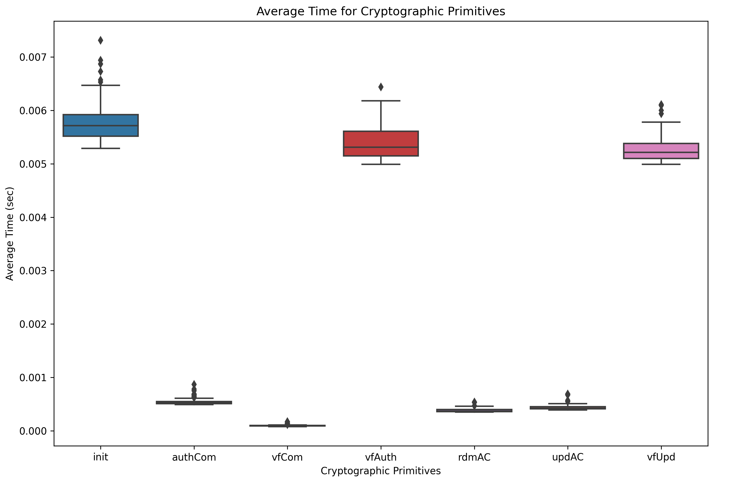
Experiments & Conclusion
Off-Chain Cost
import matplotlib.pyplot as plt
import seaborn as sns plt.figure(figsize=(12, 8), dpi=300)
sns.boxplot(data=df)
plt.show()
Environment | Value
Library | MCL
Curve | BN-128
CPU | 2 * Intel Xeon Platinum vCPU
Memory | 2GB
OS | Ubuntu 18.0.4

Slide 26
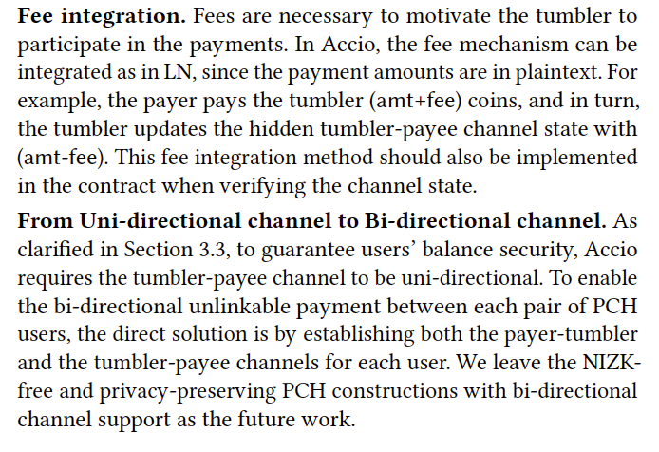
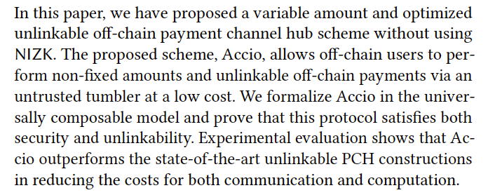
Experiments & Conclusion
Conclusion

Slide 27
Thanks! Questions?

